Slide 1
Building and deploying low-cost apps with SQL Server and .Net Core
Peter Willmot
peter@Qri.ie

Slide 2
Our focus for this session
We have SQL database(s) and .Net app(s)
We want to minimise running costs …..
For on-premise scenarios:
.Net Core is available for Linux
Therefore, you do not need the Windows server license
MS SQL Server is also available for Linux and Mac
SQL Express could be appropriate for small worksets
In the cloud, Azure VM costs for Ubuntu approx 60% of Windows (for same hardware)
Most importantly …… our primary skill-set is .Net and SQL

Slide 3
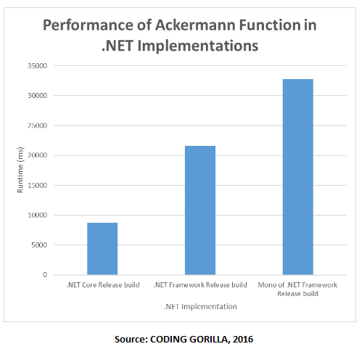
Comparing our .Net platform options
 | .Net Fx (Windows only) | Mono (Win/Mac/Linux) | .Net Core (Win/Mac/Linux)
ASP.Net | WebForms (ASPX) MVC webAPI Web Pages WCF | WebForms (ASPX) MVC webAPI Web Pages | *** Missing *** MVC webAPI Web Pages Client only
Entity Framework | Yes | Most | EF Core
Console App | Yes | Yes | Yes
Service applications | Yes | daemon | daemon
Windows Forms | Yes | *** some *** | *** Missing ***

Slide 4
What about MS SQL on Linux?
MS SQL Server Component/Option | Missing on Linux
MS SQL Database Engine NB: Standardised code base since SQL 2016 Integration Services Runtime | Multiple instances (but you could use Docker) Distributed Query Windows Integrated Authentication UNSAFE CLR Merge Replication StretchDB Polybase System extended Stored Procedures Filestream Buffer pool extension SQL Reporting Services SQL Analysis Services Master Data Services
Note: The same license fees apply for both Windows and Linux platforms even though you don’t get all the add-on components on Linux!

Slide 5
SQL Express DB Engine limitations?
Processor | Lesser of 1 socket or 4 cores (per instance)
Buffer pool | <= 1410 MB (per instance)
ColumnStore Cache | <= 352 B (per instance)
Memory optimised object store | <= 352 MB (per instance)
Database size | <= 10 GB (per DB - sum of log + data files)
High availability features | DB Snapshot only
Scalability and Performance | Extremely limited
Transparent and Backup encryption | No

Slide 6
SQL Express general limitations?
Replication | Limited
SQL Agent | No
SQL Service Broker | Client only
Reporting Services | Max 4GB per runtime instance and feature limitations
Analysis Services | No
Integration Services | Limited - eg Import/Export Wizard
Master Data Services | No
SQL Query Notifications | No - requires SQL Agent
SQL DB Mail | No - but you could use SQL CLR instead

Slide 7
Considerations : OS and SQL Admin on Linux
Bye-bye GUI Windows Desktop
Connect using ssh (on Windows 10 use bash otherwise try PuTTY or OpenSSH … others)
Azure Ubuntu host enables remote ssh by default
But you could use Ubuntu Desktop edition (or similar Linux distro)
MSSQL
Microsoft recommend a minimum of 3.25 GB RAM for MS SQL on Linux
For Ubuntu, use apt-get to install Server and Tools
Use SQL Server Authentication instead of Windows Integrated for all access
Provision Network Interface for external/remote access to TDS port (TCP 1433)
SQL Backup files need to be in /var/opt/mssql/data folder by default for restore

Slide 8
Considerations: .Net Core and ASP.Net on Linux
Install .Net Core
Web Server
Internet Information Server (IIS) - does not exist on Ubuntu
ASP .Net Core uses kestrel as an inbuilt basic web server platform
Defaults to listen on Port 5000
You can change Program.cs:
… but you would need to elevate privileges for this to work
For production, consider nginx
var host = new WebHostBuilder()
.UseKestrel()
.UseUrls("http://*:80")
…..

Slide 9
Considerations: .Net Development on Linux
.Net Core starts with a Command Line experience
that is the same for all supported platforms!
dotnet new XXXX:
console
web
razor
angular
react
webapi
…...
dotnet restore (optional …. mostly)
dotnet run
Worried about the Linux cli and vi editor?
try Visual Studio Code (VSCode) as an IDE

Slide 10
Any questions? GitHub: PeterWillmot/CrossPlatformSQLandDotNetCore
Peter Willmot
peter@Qri.ie

